Slide 1

Geometry
Unit 6, Lesson 13 Similarity in the Real World Volume 1, pg. 363

Slide 2


Benchmark
MA.912.GR.1.6
Solve mathematical and real-world problems involving congruence or similarity in two-dimensional figures.
volume 1, pg. 363

Slide 3
Integrated Mathematical Thinking and Reasoning Standards
MA.K12.MTR.1.1 Actively participate in effortful learning both individually and collectively.
MA.K12.MTR.3.1 Complete tasks with mathematical fluency.
MA.K12.MTR.4.1 Engage in discussions that reflect on the mathematical thinking of self and others.
MA.K12.MTR.5.1 Use patterns and structure to help understand and connect mathematical concepts.
MA.K12.MTR.7.1 Apply mathematics to real-world contexts.
volume 1, pg. 363

Slide 4

Learning Target
I can solve real-world problems involving similarity in two-dimensional figures.
volume 1, pg. 363

Slide 5

Warm-Up
volume 1, pg. 363

Slide 6
6.13.1 Warm-Up: With Math I CAN
What struggles have you had in mathematics?
Students often ask teachers, “When will I ever use this?” What is one thing in mathematics you’ve wondered if you would ever use?
Sometimes it isn’t that a job requires you to prove a theorem, but to use the logical thinking you learned in proving a theorem. Describe a few careers that you’re interested in and what can you do with math.
volume 1, pg. 363

Slide 7

Activity
volume 1, pg. 364

Slide 8

6.13.2 Activity: Real-World Problem Gallery Walk
Complete each problem by recording your work and answer in the spaces provided.
Problem | Work | Answer
Problem A
Problem B
volume 1, pg. 364

Slide 9
Problem | Work | Answer
Problem C
Problem D
volume 1, pg. 364

Slide 10
Problem | Work | Answer
Problem E
Problem F
volume 1, pg. 365

Slide 11

Wrap-Up
volume 1, pg. 365

Slide 12
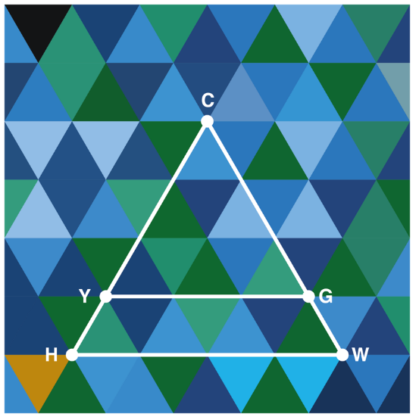
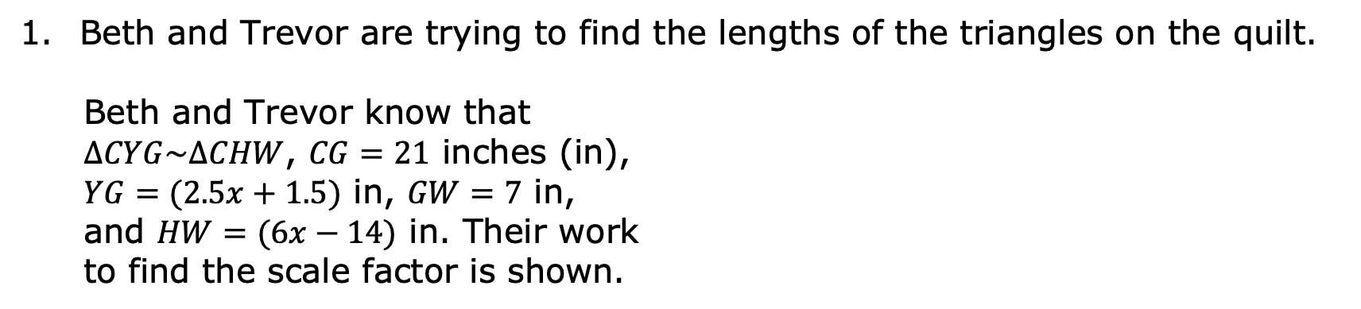
6.13.3 Wrap-Up: Ticket Out the Door
Beth and Trevor are trying to find the lengths of the triangles on the quilt.
Beth and Trevor know that $∆CYG\sim ∆CHW$, $CG=21$ inches (in), $YG=(2.5x+1.5)$ in, $GW=7$ in, and $HW=(6x−14)$ in. Their work to find the scale factor is shown.
volume 1, pg. 365

Slide 13
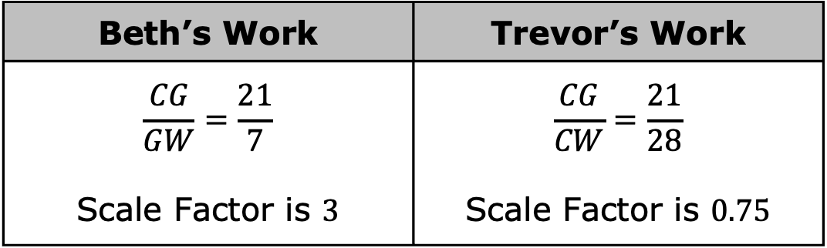
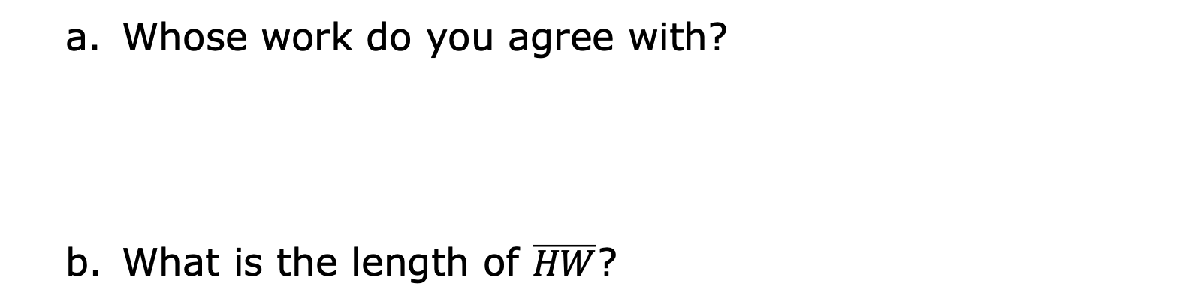
Beth’s Work | Trevor’s Work
$$\frac{CG}{GW}=\frac{21}{7}$$ Scale Factor is $3$ | $$\frac{CG}{CW}=\frac{21}{28}$$ Scale Factor is $0.75$
Whose work do you agree with?
What is the length of $\overline{HW}$?
volume 1, pg. 365

